Slide 1
Numerical simulations of sunspots From sunspot fine structure to the scale of active regions Matthias Rempel (HAO/NCAR) Collaborators: M. Knölker (HAO), M. Schüssler, R. Cameron, L. Bharti (MPS, Germany), M. Cheung (LMSAL), A. Tritschler, H. Uitenbroek (NSO), SDO Science Center Team
The National Center for Atmospheric Research is operated by the University Corporation for Atmospheric Research under sponsorship of the National Science Foundation.

Slide 2
Outline
Introduction
Why do we study sunspots
Numerical approach
Main challenges
Numerical scheme
Sunspot models
Sunspot fine structure
Umbral dots, penumbral filaments, Evershed flow
Subsurface structure
Magnetic structure and stability, large scale flows, helioseismology
Sunspot formation
Flux emergence in upper most 16 Mm of convection zone

Slide 3
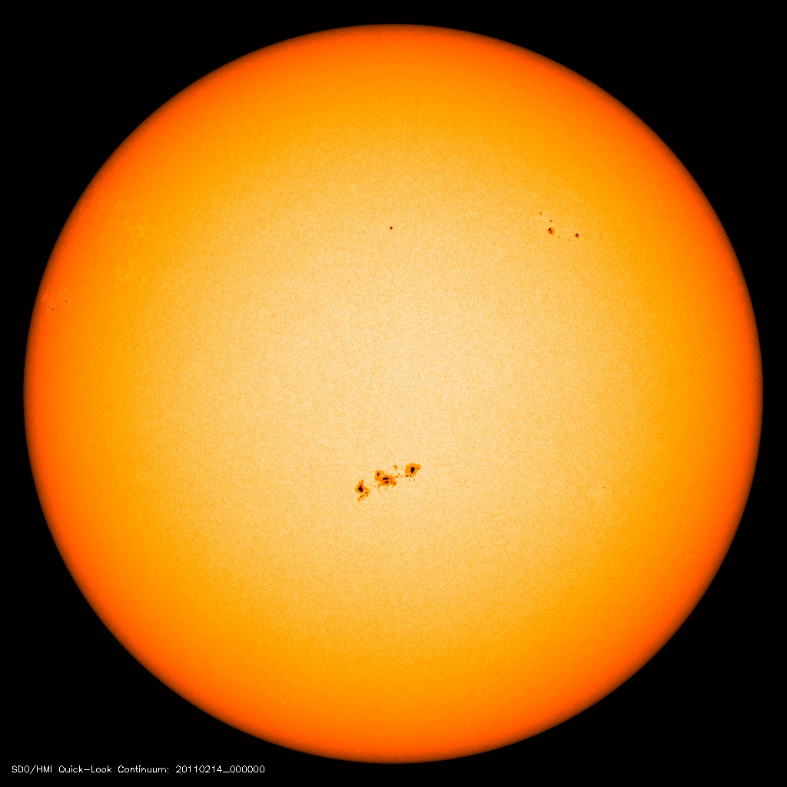
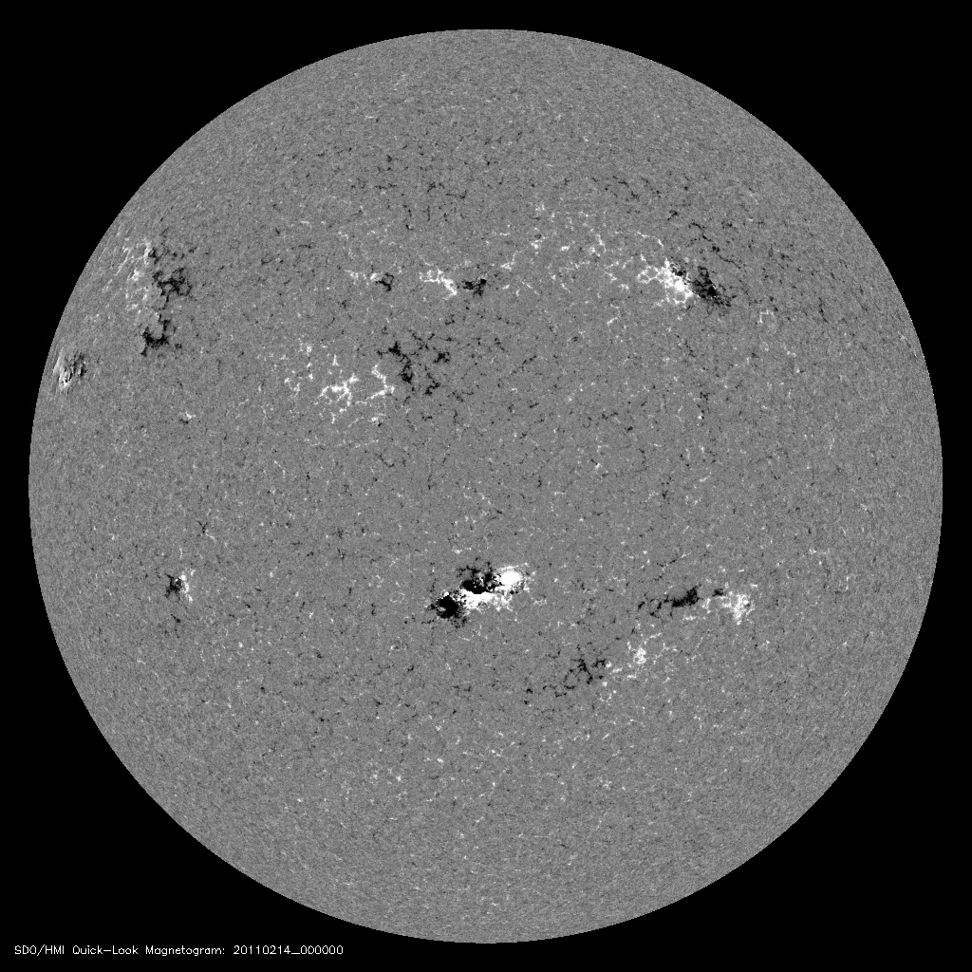
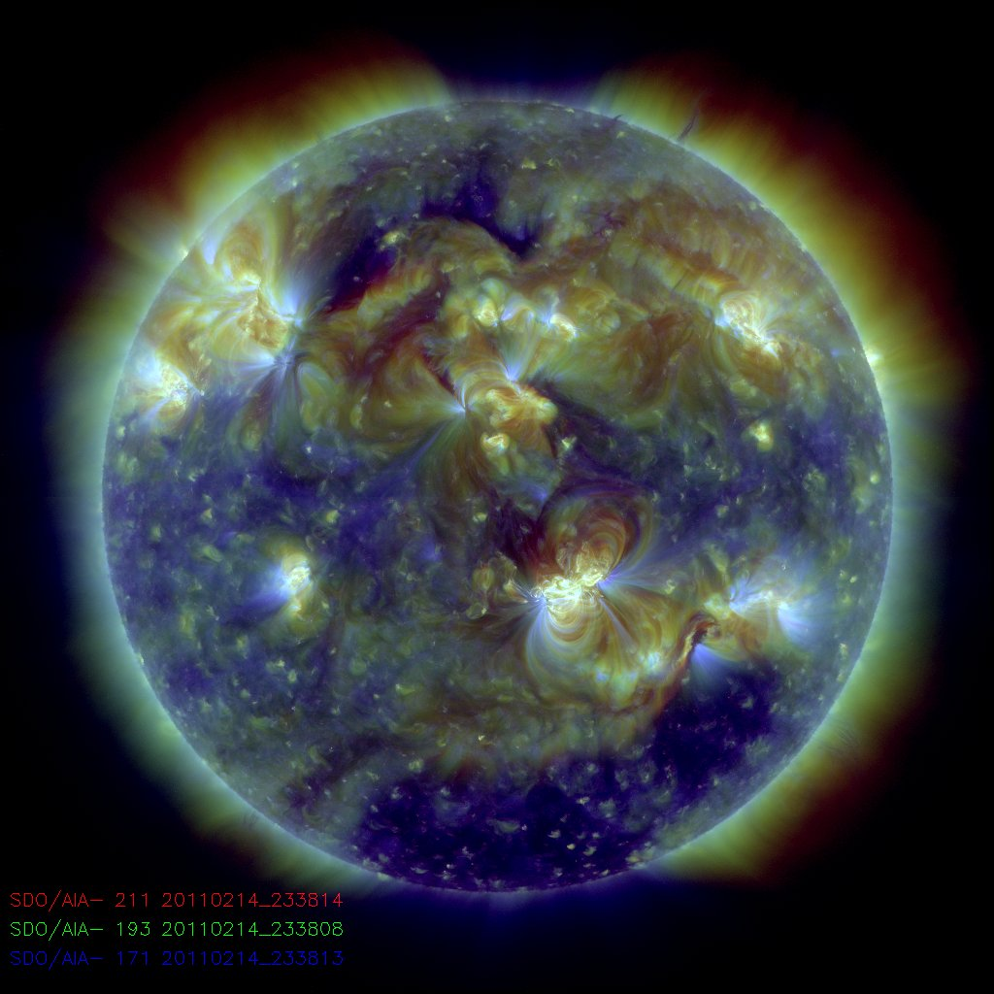
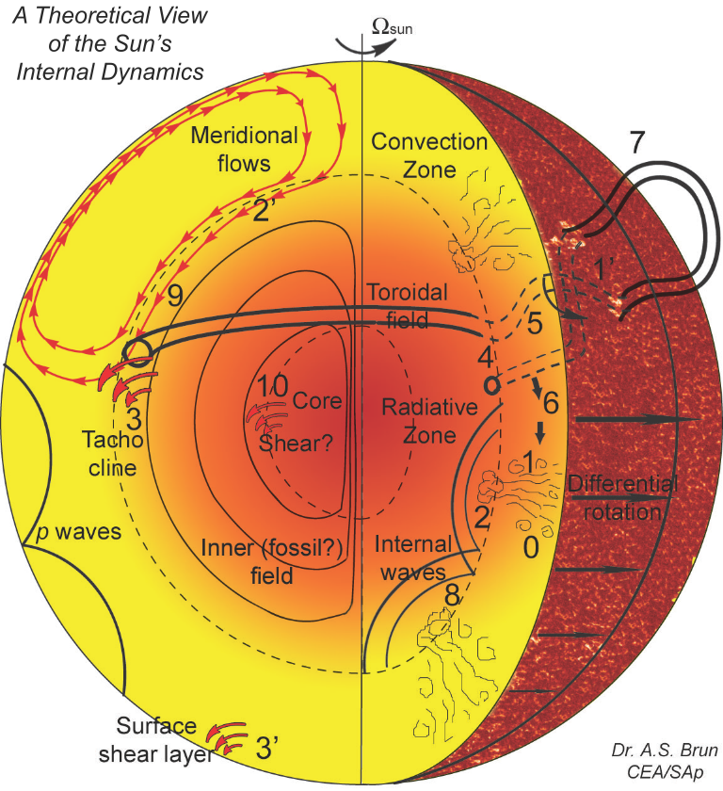
Solar context
HMI/AIA SDO, NASA
Sunspots most prominent manifestation of large scale field on solar surface
Key for understanding solar interior (dynamo)
Key for understanding solar magnetic field and variability in photosphere and above
Credit: S. Brun

Slide 4
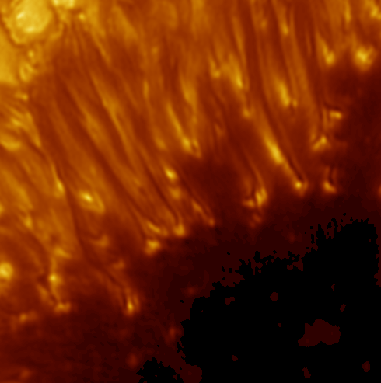
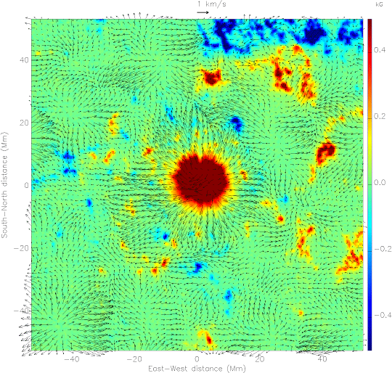
Plasma lab for studying magneto-convection
Sunspot fine structure, SST (Sweden)
Moat flow: F-mode inversion (Gizon et al. 2000)
Evershed flow (M. Franz, KIS)

Slide 5
Numerical sunspots models: challenges
Multi scale problem
Typical size > 20 Mm
Fine structure < 200 km
Need < 20 km resolution in numerical simulations
Time scales required
Hours (fine structure)
Days (evolution, moat region)
Numerical time steps ~ 0.1 sec (after limiting Alfven velocities)
Challenging numerical problem
Billions of grid points
100,000 to 1,000,000 time steps
Scharmer et al. (2011), SST

Slide 6
Numerical models
Basic ingredients (Modified MURAM code, Vögler et al.)
Single fluid MHD
4th order + hyperviscosity (slope limited diffusion scheme)
Artificial limitation of Alfven velocities
3D radiative transfer (short characteristics in 24 directions)
OPAL equation of state (interpolation in table)
Scales to >10,000 CPUs
Boundary conditions
Horizontal: periodic
Top: - potential field (or prescribed inclination) - closed for flows
Bottom: - vertical field (fixed in shallow domains) - open for convective flows
Initial state
Thermally relaxed HD simulation
Axisymmetric magnetic field with typical sunspot flux/field strength

Slide 7
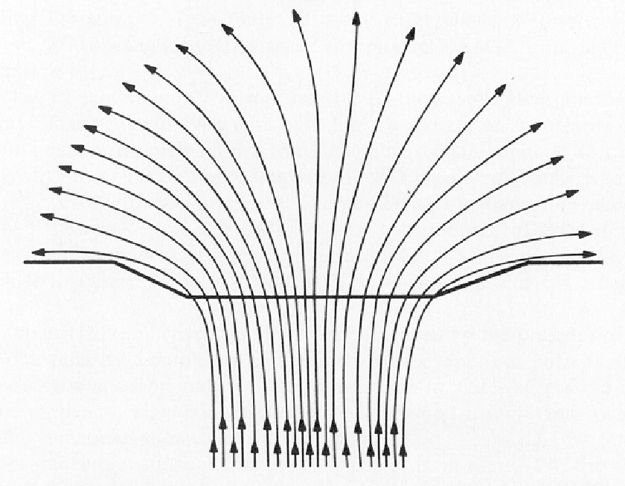
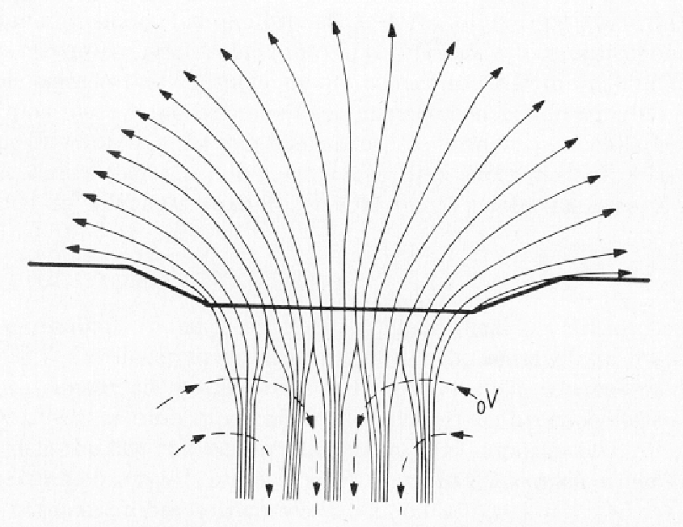
Key questions of sunspot structure
Energy transport in sunspots, fine structure
Umbral dots
Penumbral filaments
Light bridges
Origin of the Evershed flow
High resolution -> sections of sunspots or shallow domains, short time scales
Subsurface structure, moat flows, sunspot formation
Subsurface field strength/field topology?
Evolution/Decay of sunspots
Moat flows
Helioseismic forward modelling
Long time scales, deep domains -> low resolution
Scharmer, SST
Parker (1979)

Slide 8
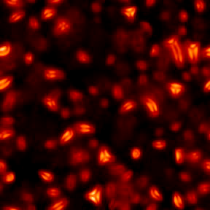
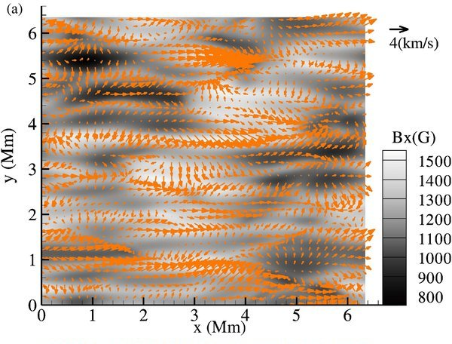
Recent progress in MHD modeling of sunspots
Schüssler & Vögler (2006)
Heinemann et al. (2007) Scharmer et al. (2008)
Kitiashvili et al. (2009)
Rempel et al. (2009)

Slide 9
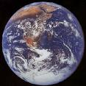

Slide 10
Sunspot fine structure highest resolution, short time scales, shallow domains
Resolution:
16x16x12 km
(3072x3072x512)
Computing resource:
NSF-Teragrid
Cray-XT5 (Kraken, NICS)
3072-12288 cores
1 solar hour
~ 3 days (on 12288 CPUs)
~ 800,000 CPU hours
~ 10 TB data (3 TB/day !)
Data handling major challenge!
Achieved data rates larger than SDO mission!

Slide 11
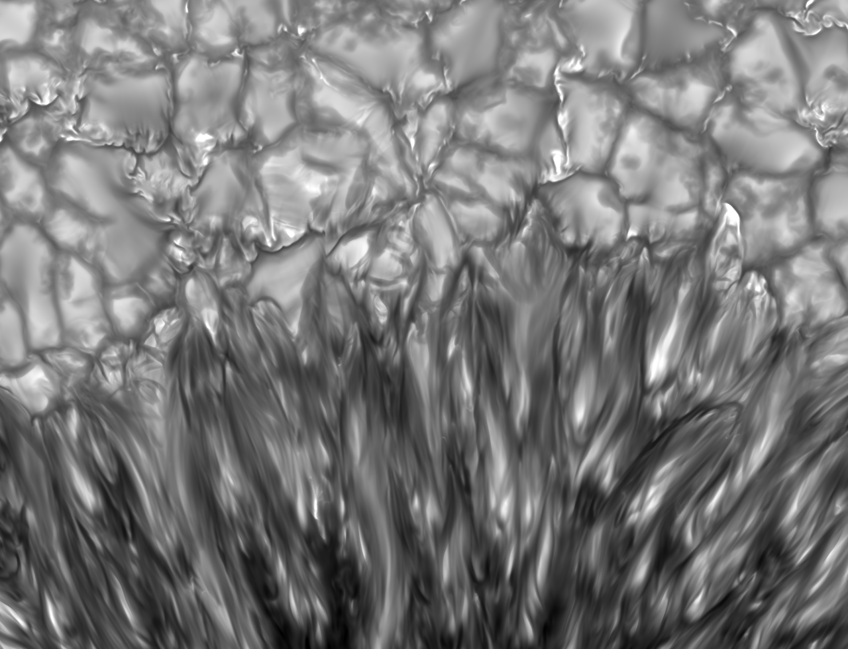

Slide 12
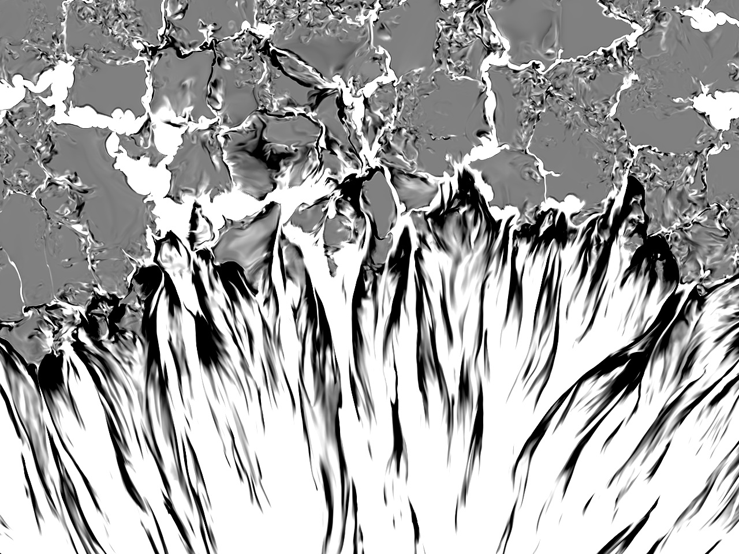

Slide 13
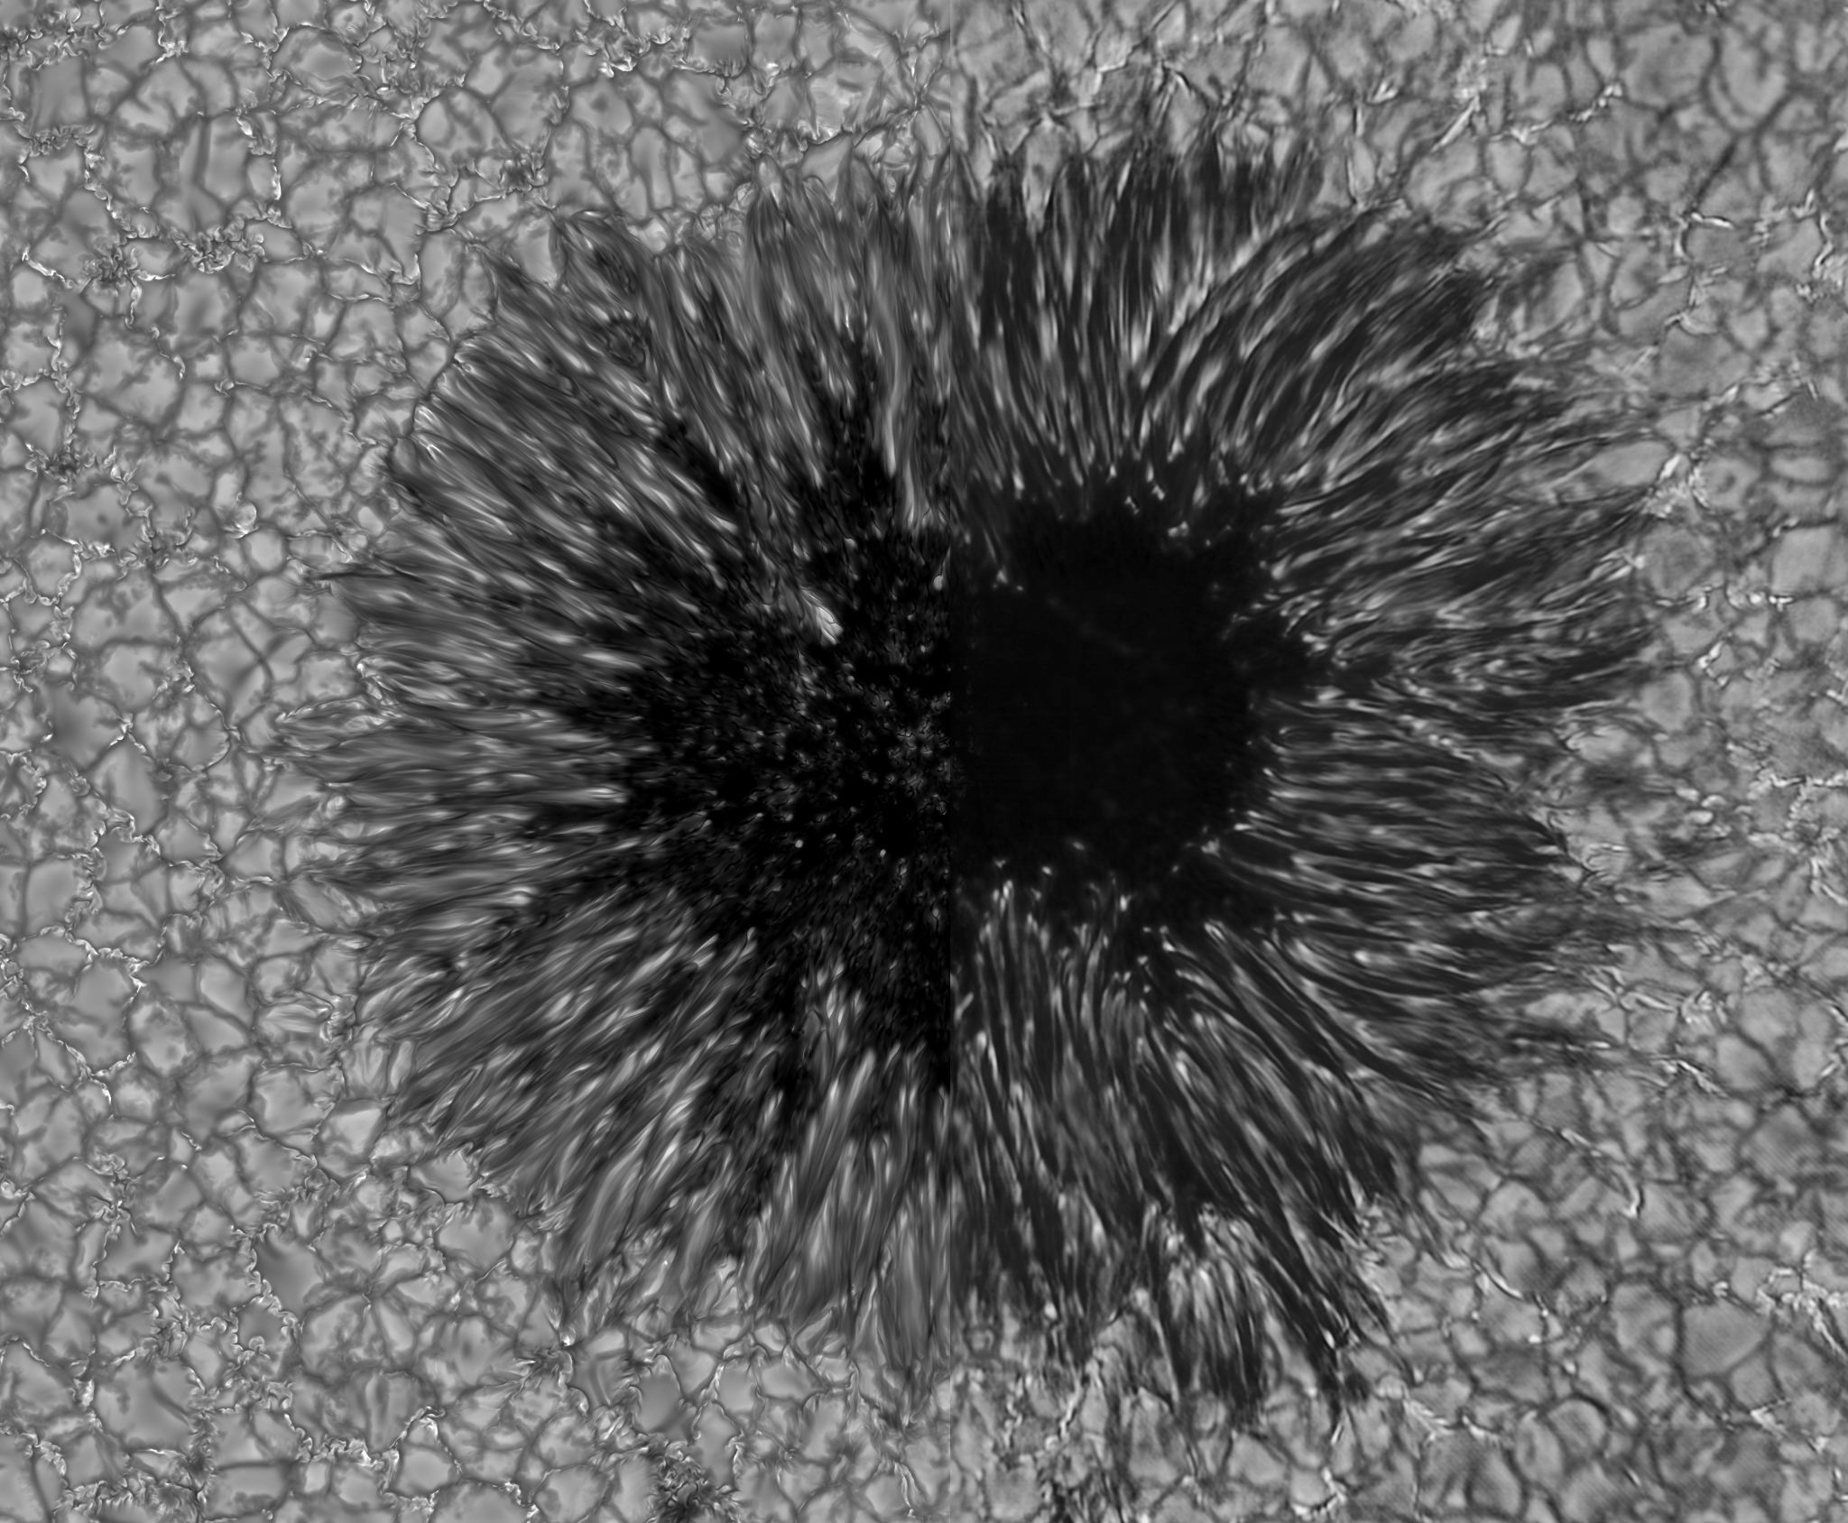
Simulation versus Reality

Slide 14
Simulation versus Reality
Simulation (non-grey) Observation (Dunn Telescope)
12x12x8 km F. Woeger (NSO)

Slide 15
Vertical cut through center of spot (upper most 3 Mm)
|B|
T
Vx
Vz

Slide 16
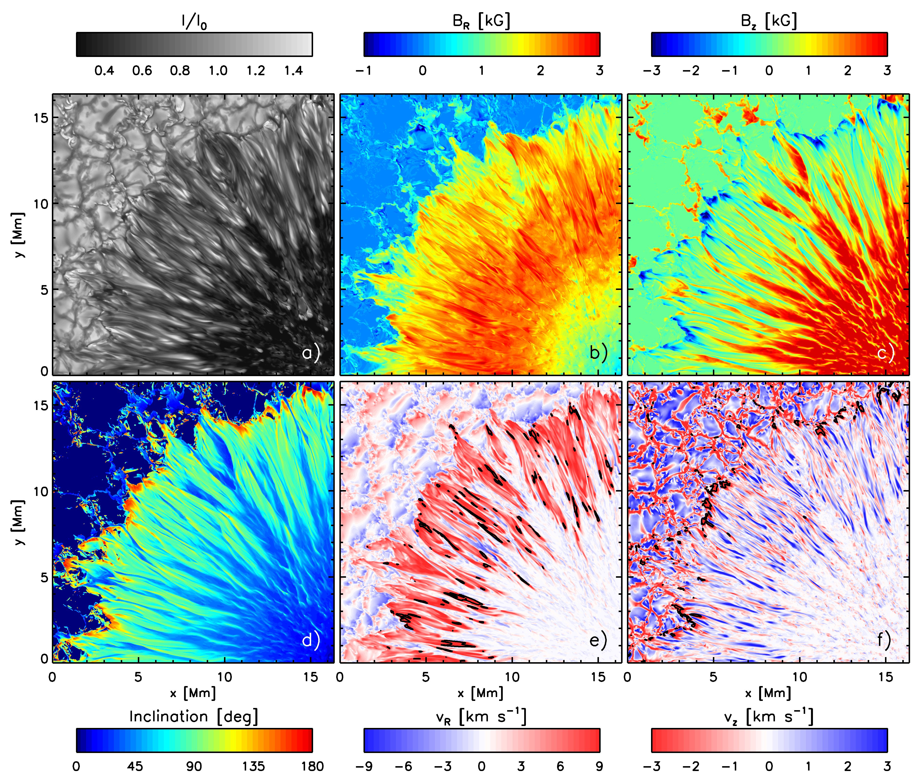
Sunspot fine structure (at tau=1)

Slide 17
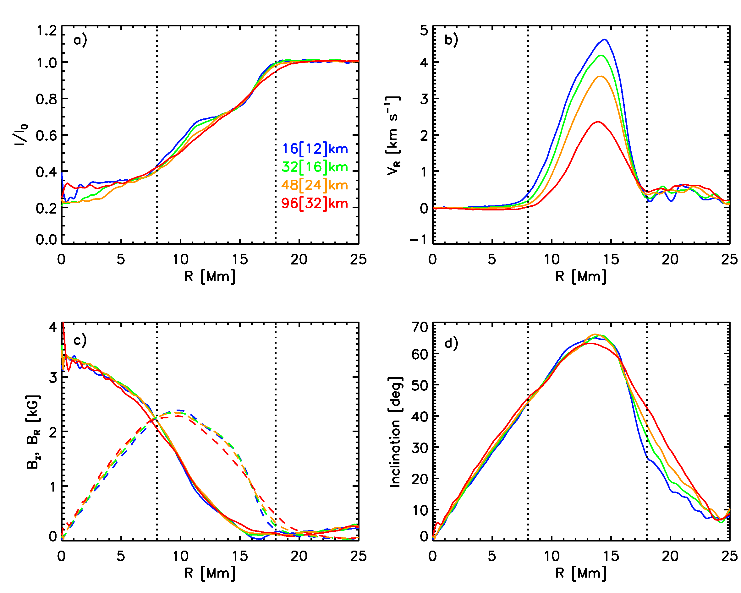
Azimuthal averages (at tau=1)

Slide 18
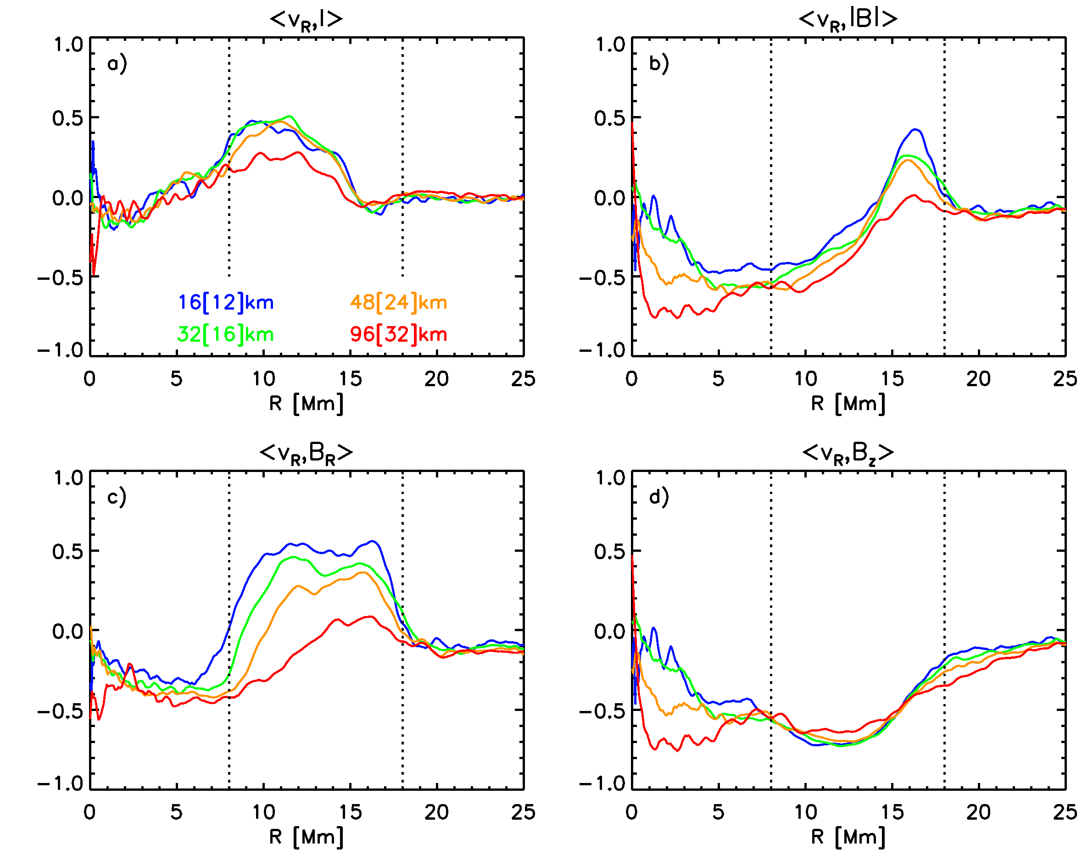
Correlations in flow channels

Slide 19
Filament cross sections (inner penumbra)

Slide 20
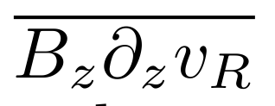
Average properties in regions with V_{z} & V_{R} >0
V_{R}/2
V_{z}*P_{z}
V_{R}*L_{R}
T
B_{R}
V_{z}
V_{z}*L_{z}
V_{R}*A_{R}
B_{z}
Approximate force balance
Vertical:
Radial:
Translation invariant along filaments
Induction equation
Stretching:
Advection:
Divergence

Slide 21
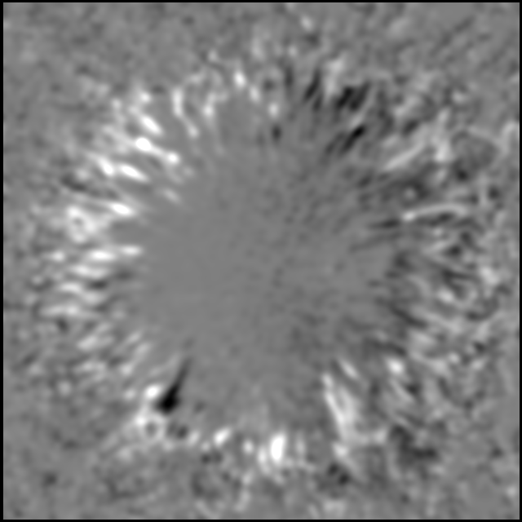
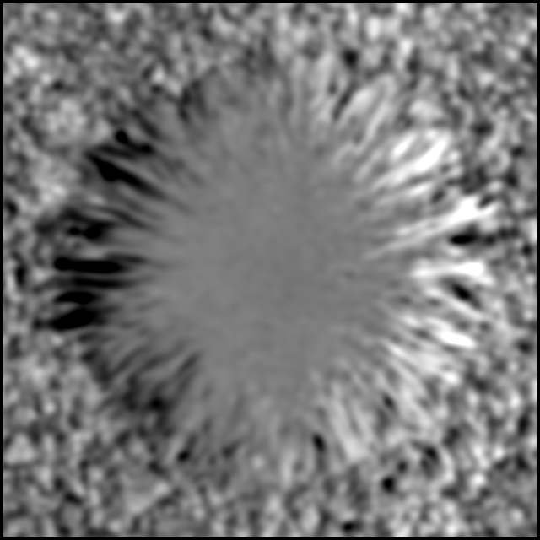
Field strength in flow-channels and NCP
Observation:
Tritschler etal. 2007
Forward modeling:
Tritschler,
H. Uitenbroek

Slide 22
What determines the Evershed flow velocity?
Balance between energy conversion by vertical and horizontal Lorentz forces:
Implies
Vertical confinement of boundary layer requires:
Should expect Alfvenic Evershed flow

Slide 23
Magnetic field structure of penumbra
www.vapor.ucar.edu

Slide 24
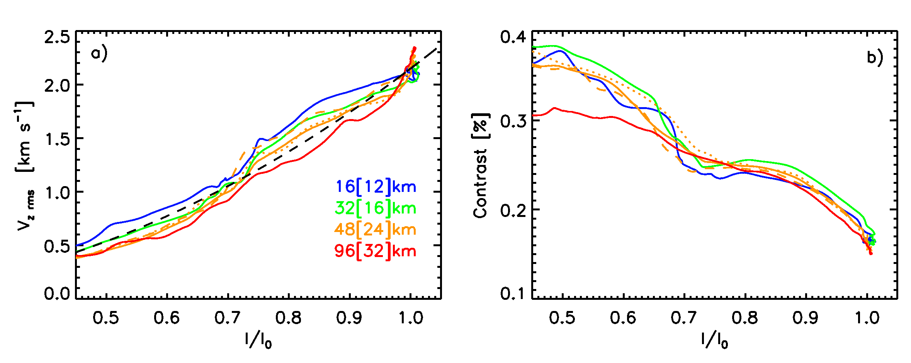
Convection everywhere – how much should we see in observations?
Scaling throughout penumbra
Expect 50% of granulation v_{z}^{rms} in penumbra
Franz & Schlichenmaier (2009)

Slide 25
Visibility of overturning motions
Detailed analysis in progress (Bharti, Schüssler & Rempel, submitted)
Visibility of downflows depends strongly on selected field line and distance from disc center
Fe I 7090: 200 m/s (comparable to noise + uncertainty)
C I 5380: 800 m/s
Optimistic estimates (no blends, no straylight, no noise)
Already moderate viewing angles of a few deg make a big difference (8 km/s Evershed flow near tau=1 in flow channels)

Slide 26
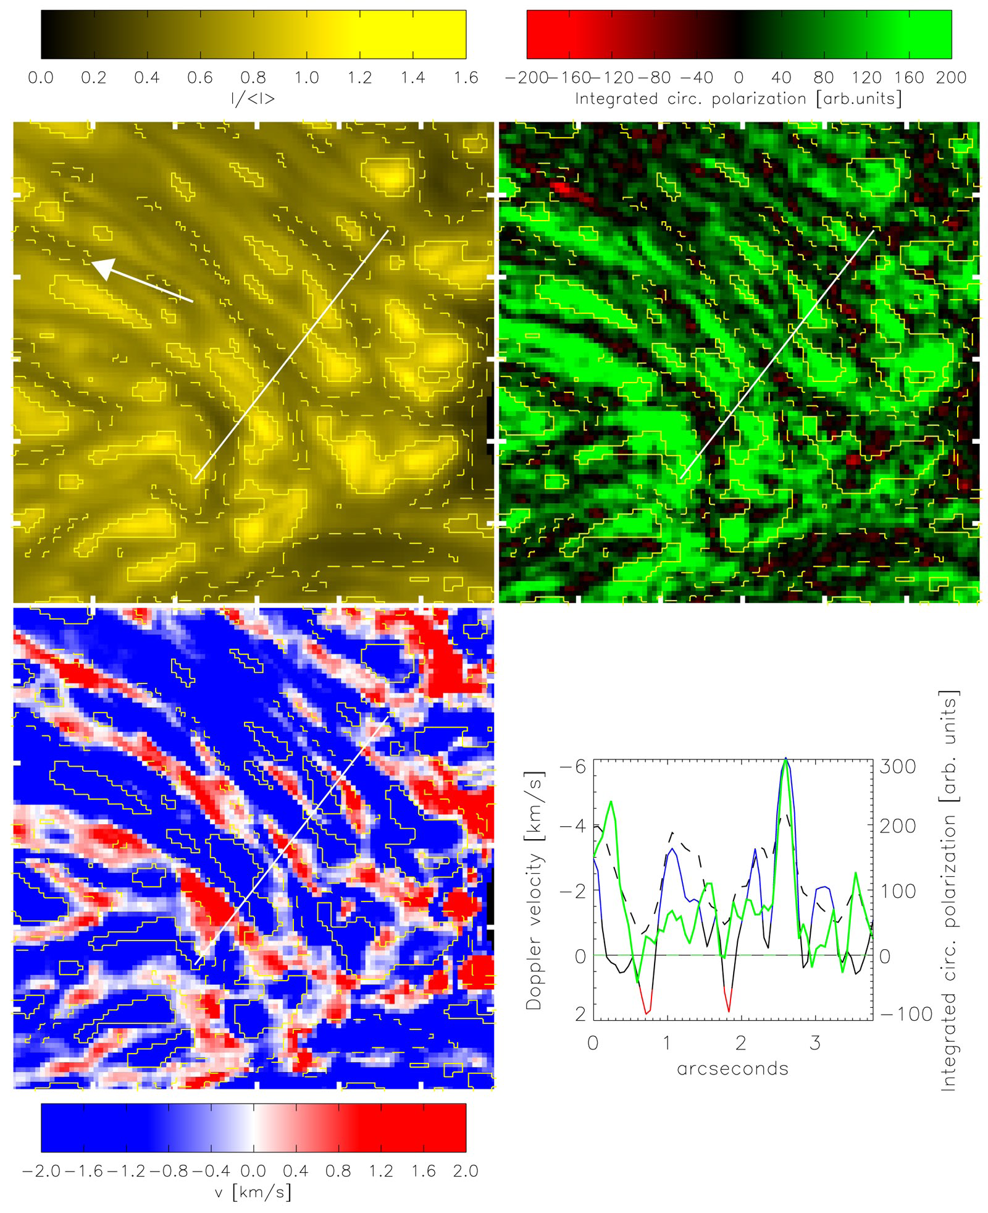
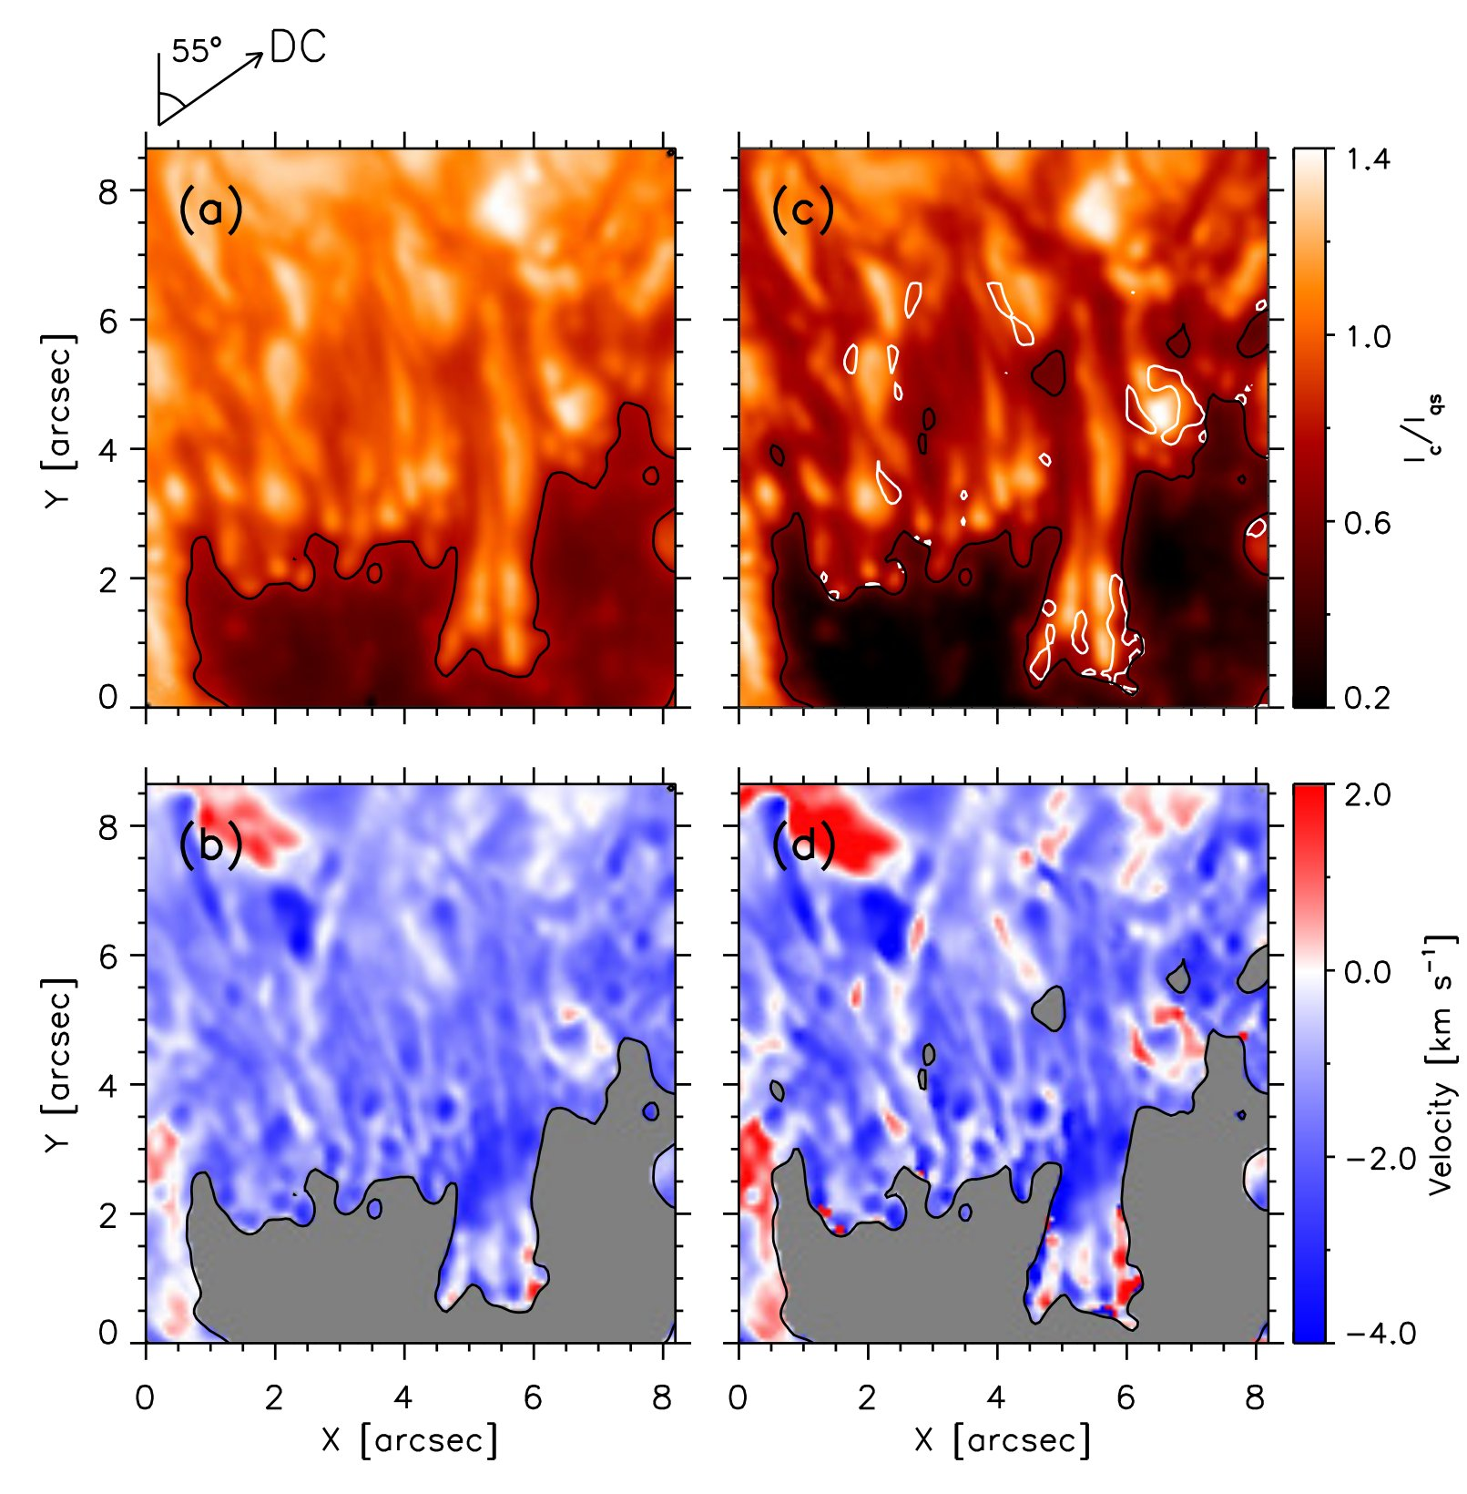
Observations in C I 5380
Joshi et al. 2011 Scharmer et al. 2011
Dowflows ~ 2km/s preferentially in darker features
Problems:
Straylight compensation, line blends
Evershed flow (both studies looked in blue shifted part of penumbra)

Slide 27
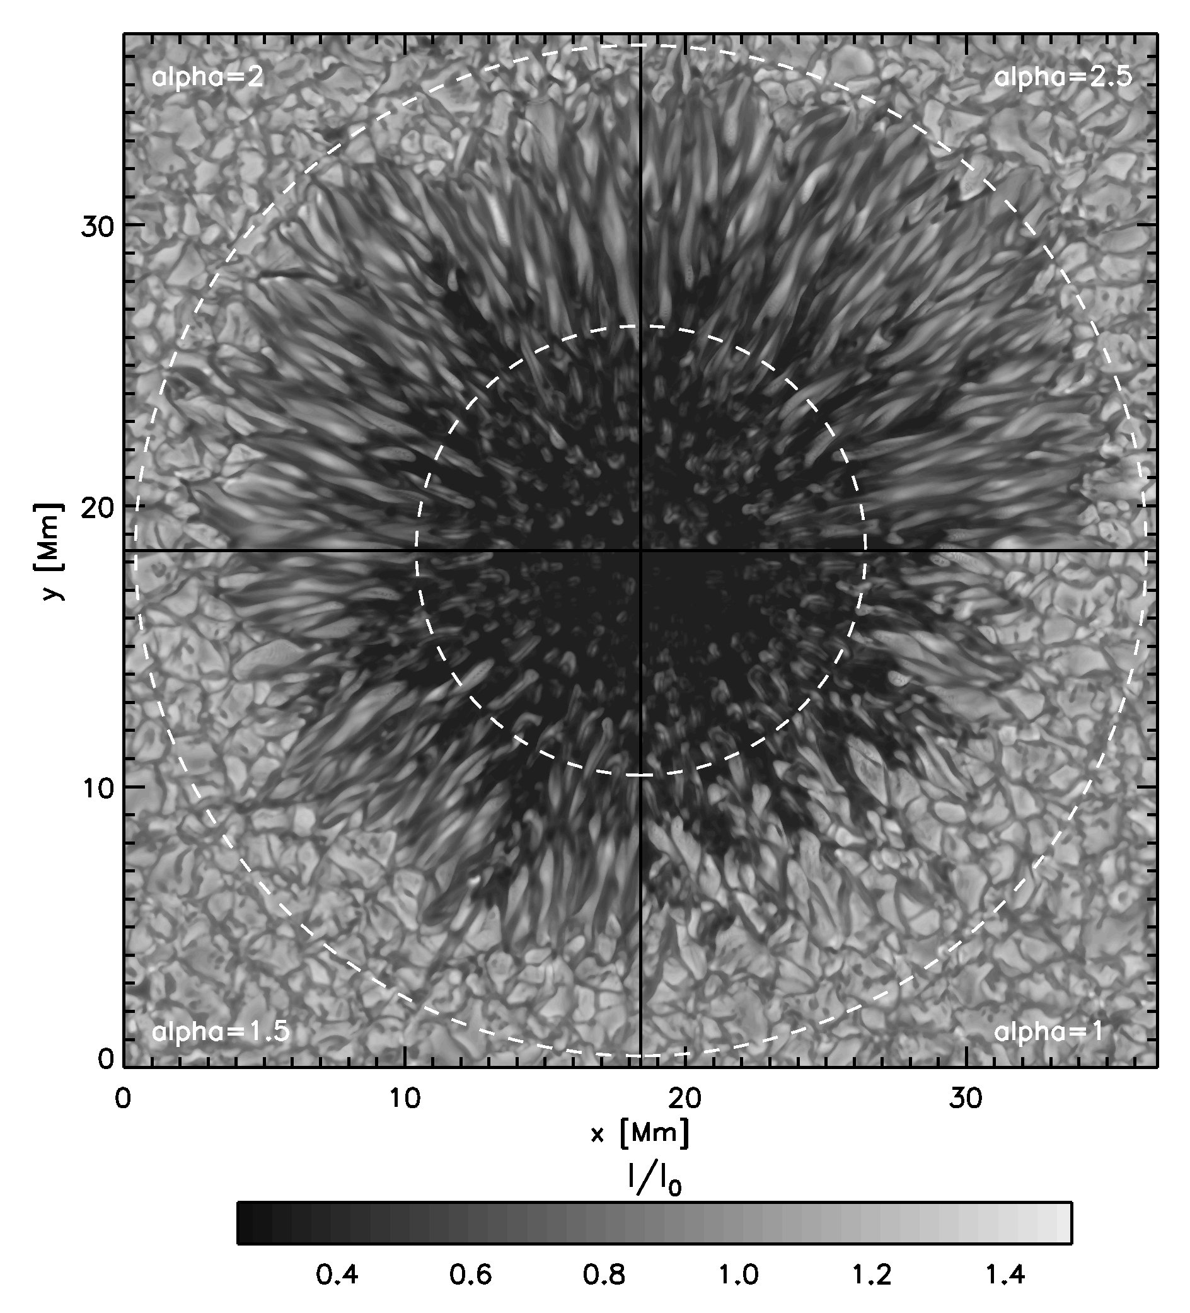
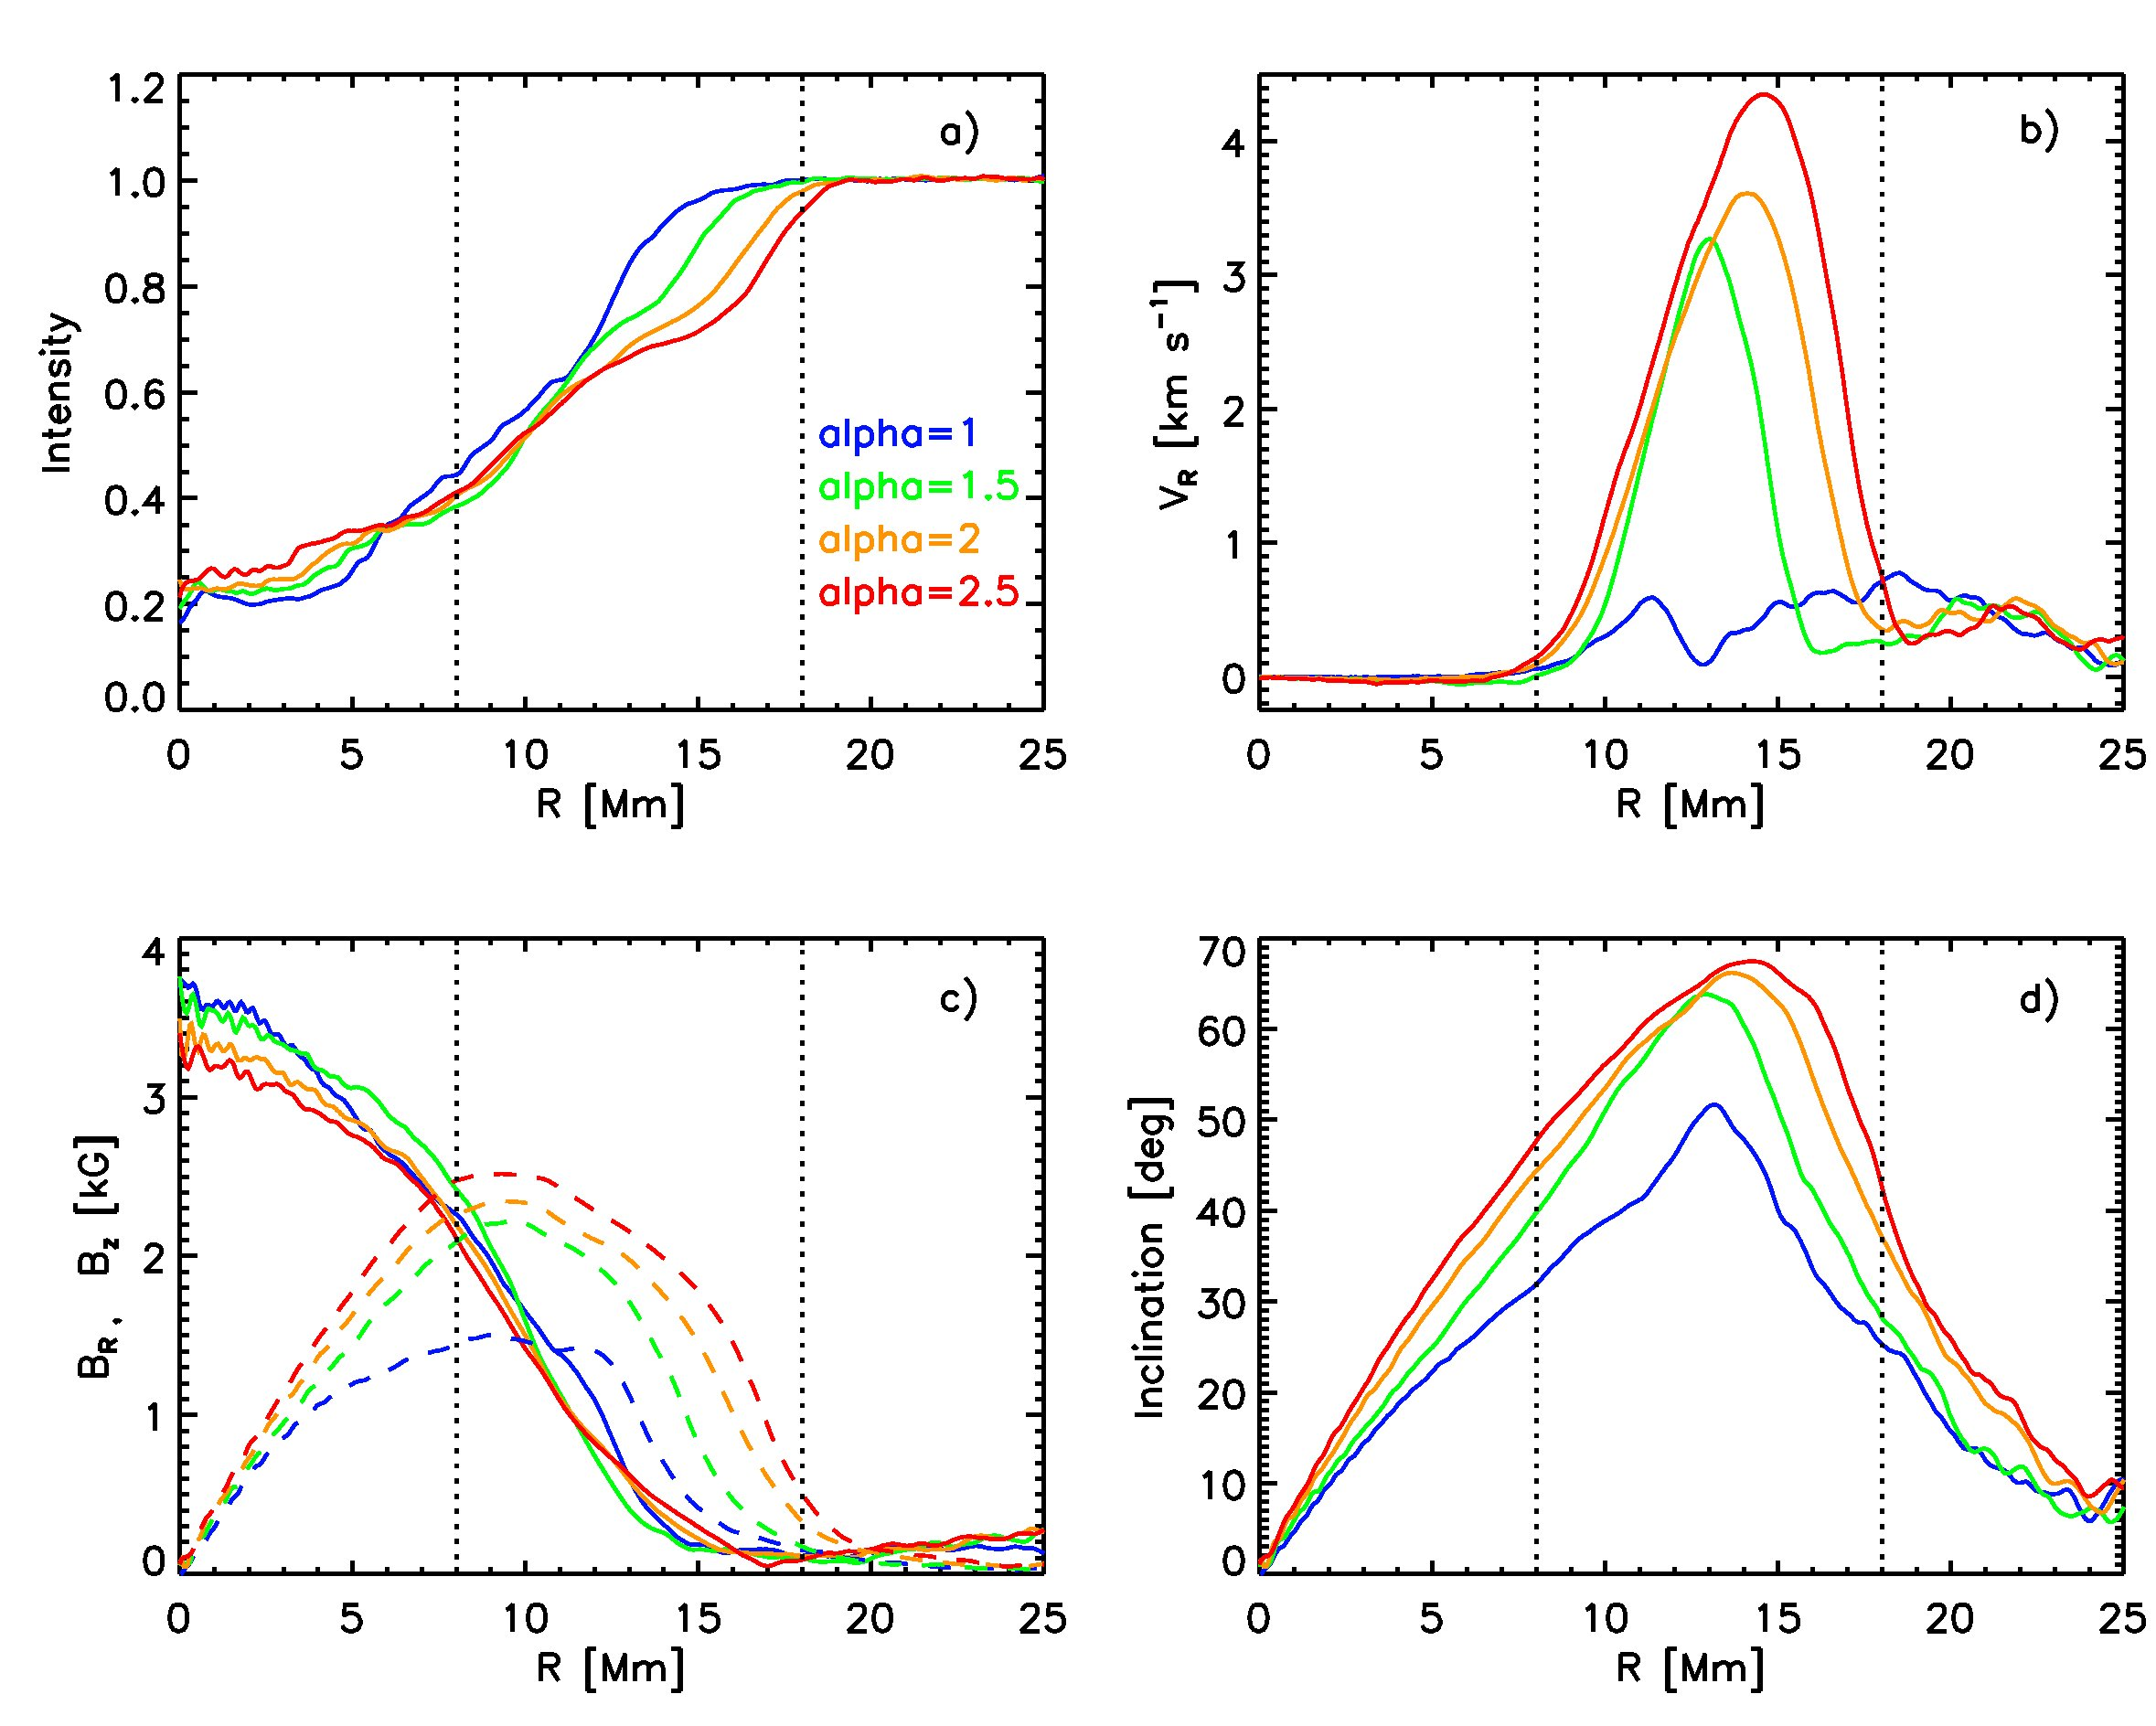
Radial extent of penumbra
Top boundary conditions determines extent of penumbra
Potential field + horizontal periodicity -> no penumbra
Still insufficient resolution for self-maintained penumbra (no indication over explored resolution range)?
Artifact of horizontal periodicity?

Slide 28
Penumbra formation/destruction through changes in top boundary condition
Only little hysteresis from within convection zone:
Formation/destruction within 0.5 hours after boundary change
Evidence in observations of flare responses
see poster by H. Wang, C. Liu, N. Deng, P22.06

Slide 29
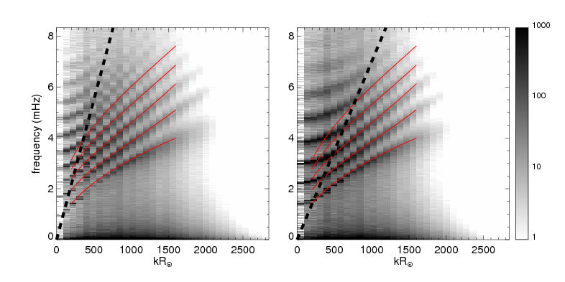
Bigger domains, longer time scales
Moat flows
Long-term evolution
Subsurface structure
Helioseismic forward modeling (SDO Science Center)

Slide 30
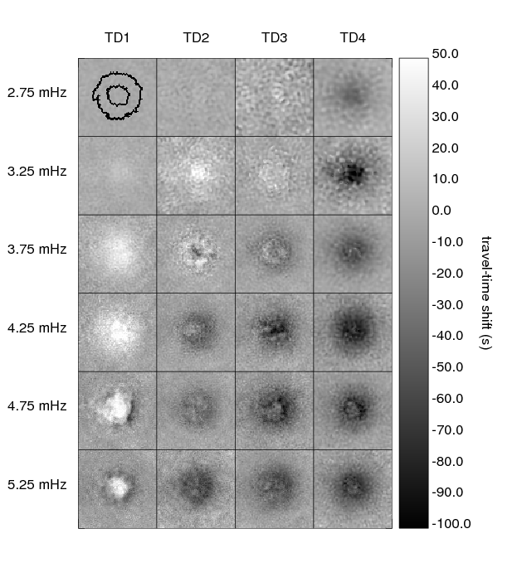
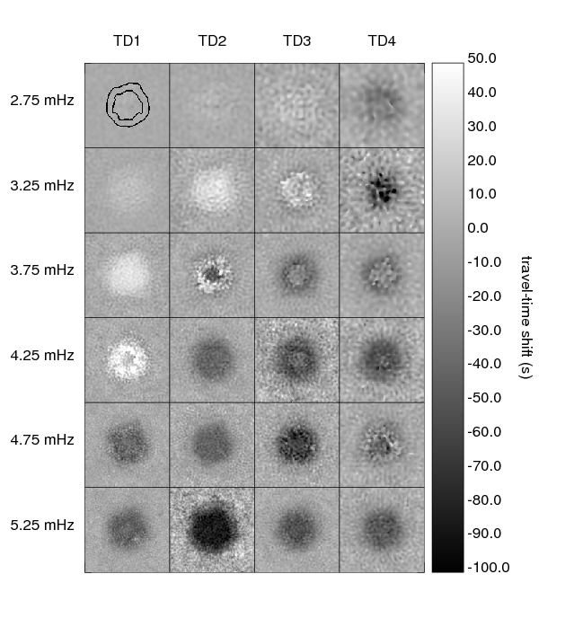
Simulation versus Reality

Slide 31
Simulation versus Reality
NOAA 11092 (HMI) REMPEL 00008

Slide 32
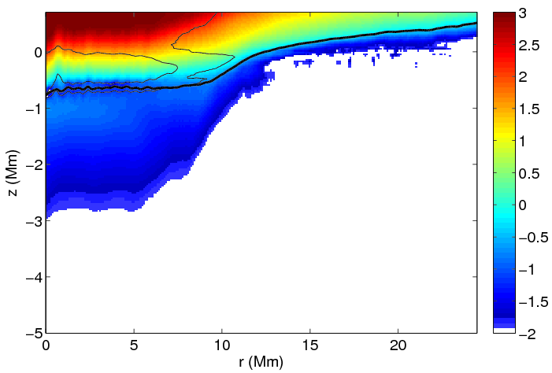
Near surface origin of helioseismic signatures
Wave speed perturbation <10⁻² in more than 3 Mm depth
Most of signal originates from near surface layers
Detailed knowledge of near surface structure required before the deep structure can be inferred
Standard inversions fail when applied to simulation data
Log10(V_{fast})
See poster by D. Braun, A. Birch, M. Rempel & T. Duvall
P16.07

Slide 33
Longterm evolution and sunspot decay Role of bottom boundary condition
|B| |B| I
Fixed B
Open
-11.5 Mm -3.3 Mm

Slide 34
Deep flow structure
V_{R}
V_{Z}
z = -11.5 Mm -3.3 Mm -1.3 Mm

Slide 35
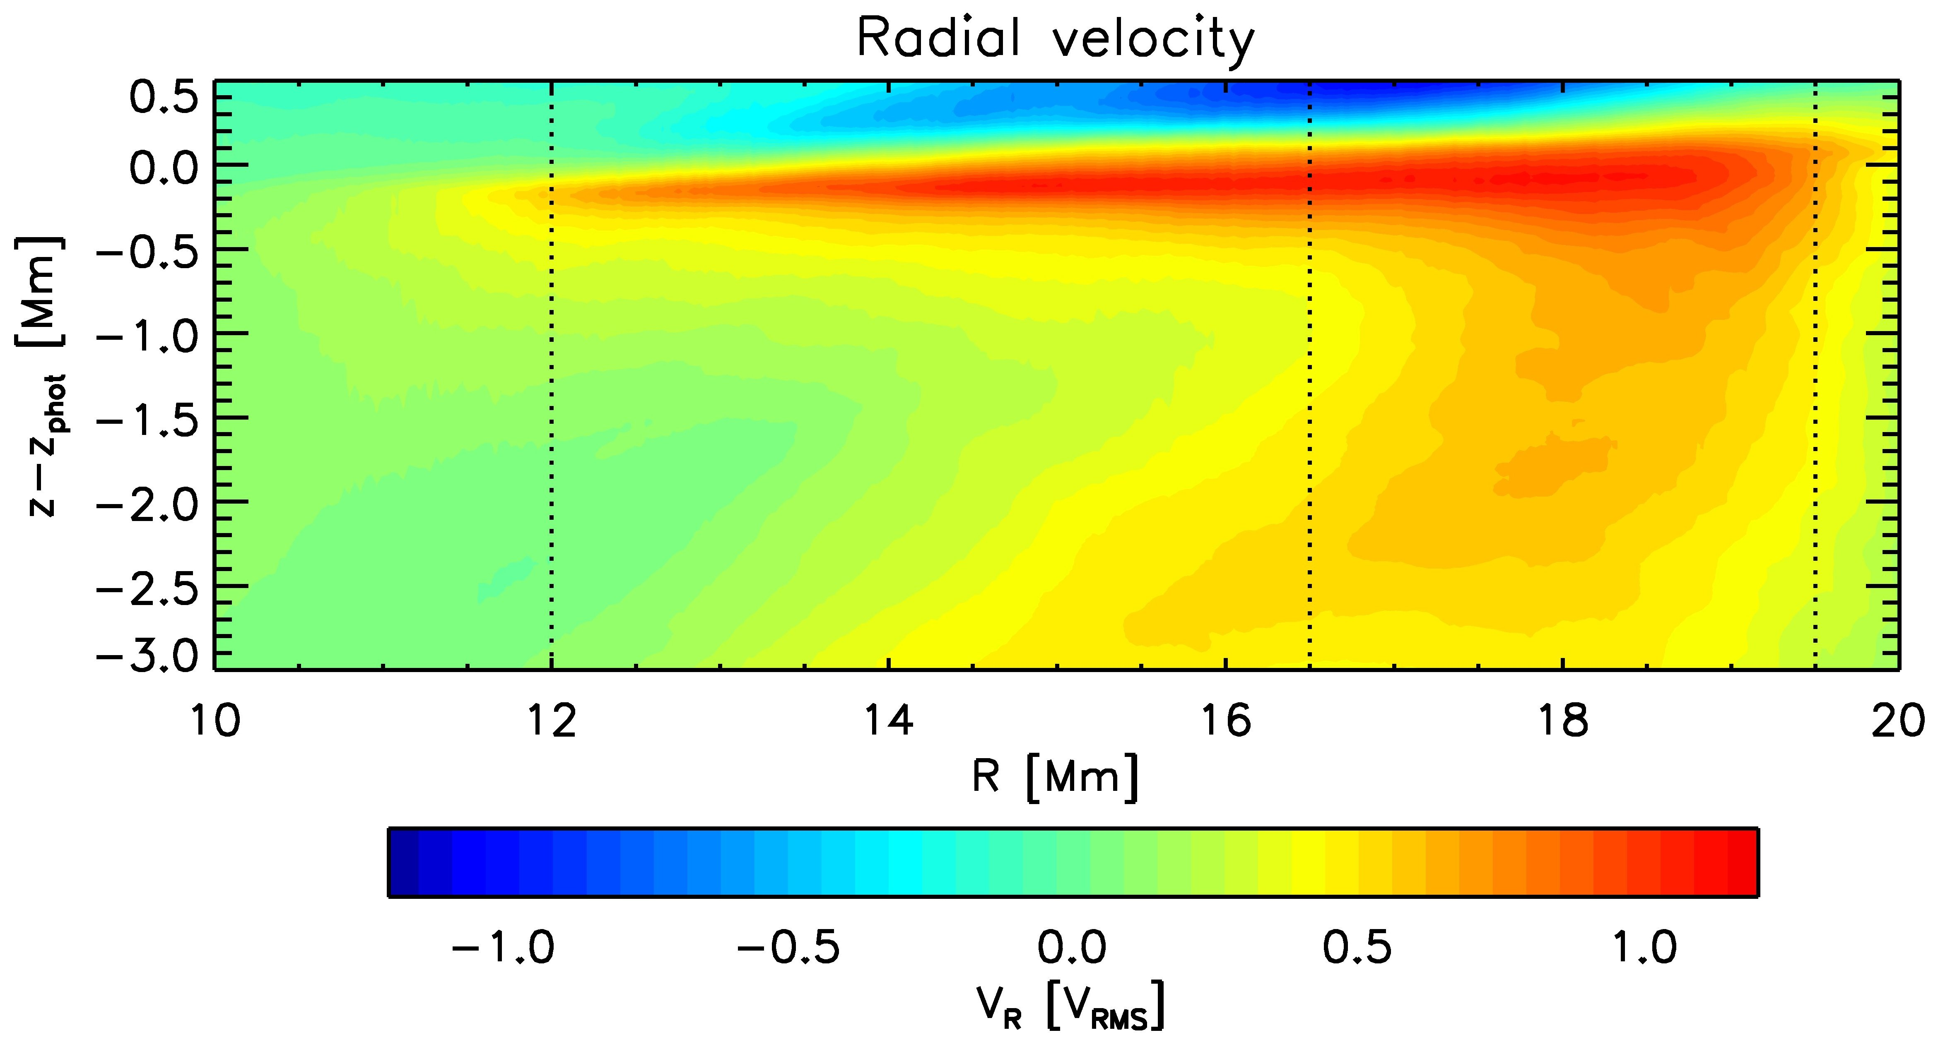
Subsurface flow structure
No Penumbra
Penumbra
0 10 20 30 Mm
Deep reaching outflow cell ~0.5 Vrms
Independent from Evershed flow
Weak inflow near spot in absence of penumbra
Photospheric flow 300 - 600 m/s in both cases
0 10 20 Mm

Slide 36
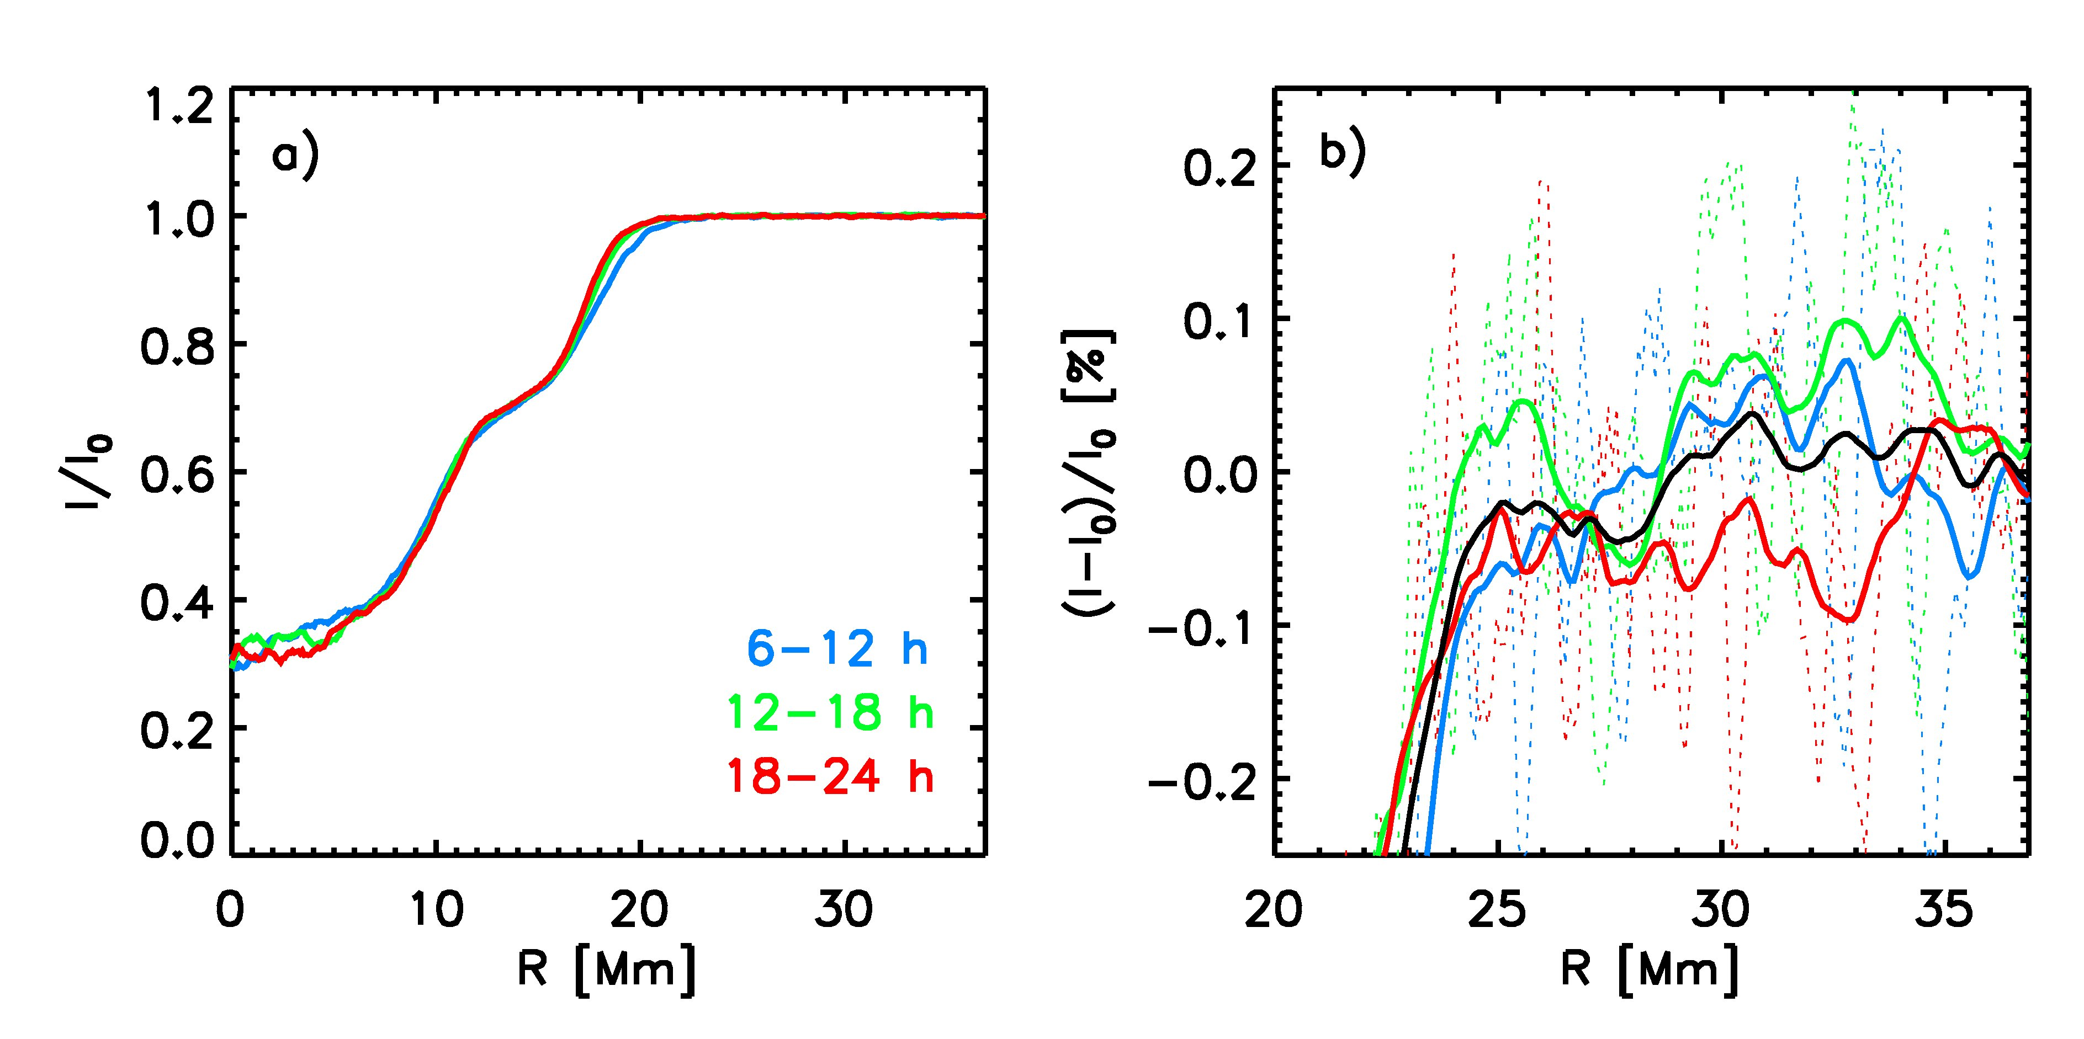
Bright rings around sunspots?
If there is any systematic variation of I present in the simulation it is not more than 0.05%
Heat flux blocked by umbra does not enter simulation domain
Temperature enhancement of 0.5 T_{rms} underneath penumbra

Slide 37
Flux emergence, sunspot formation
Observational evidence:
Flux emergence
Strong expansion
Opposite polarities separate
Concentration into strong spots
Key problem:
Strong expansion (density contrast ~10⁶)
B~ρ^{ε} ε = 1/2 …. 2/3
100 kG (BC) -> 100 G
How to get 3 kG out of this?
Hinode SOT

Slide 38
Flux emergence, sunspot formation largest domains (active region scale)
Magnetogram
(tau=1)
Domain size:
150x75x16 Mm
V_{Z} / |V|
Up Down
|B|
(vertical slice)
Cheung & Rempel in prep.

Slide 39
Conclusions
Overall, a coherent picture of sunspot structure from scales of fine structure (umbral dots, penumbral filaments) to scales of the moat region is emerging:
Simulations from 96x32 to 16x12 km resolution
Domain size up to 74 Mm wide and 16 Mm deep
Up to 50 h duration
Magneto-convective origin of fine structure numerically robust
6x horizontal, 2.66x vertical resolution
Extent of penumbra and long-term stability of sunspots subject to boundary conditions
Top: Extent of penumbra
Bottom: Long-term stability and decay
Detailed comparison with observations
Forward modeling of spectral lines and polarization signals in progress
Explore sunspot formation and decay process

Slide 40
Computing resources where provided by
NSF
National Center for Atmospheric Research
Texas Advanced Computing Center (TACC) University of Texas at Austin
National Institute for Computational Sciences (NICS)
NASA
NASA Advanced Supercomputing (NAS) Facility NASA Ames Research Center
NCAR is sponsored by the National Science Foundation
Research partially funded through SDO Science Center (NASA)

